Slide 1
Java Event Handling

Slide 2
Delegation Event Model
The modern approach to handling events is based on the delegation event model, which defines standard and consistent mechanisms to generate and process events.
A source generates an event and sends it to one or more listeners. In this scheme, the listener simply waits until it receives an event.
Once an event is received, the listener processes the event and then returns.
The advantage of this design is that the application logic that processes events is cleanly separated from the user interface logic that generates those events.
A user interface element is able to “delegate” the processing of an event to a separate piece of code.

Slide 3
Events
An event is an object that describes a state change in a source.
It can be generated as a consequence of a person interacting with the elements in a graphical user interface.
Some of the activities that cause events to be generated are pressing a button, entering a character via the keyboard, selecting an item in a list, and clicking the mouse.

Slide 4
Event Sources
A source is an object that generates an event. This occurs when the internal state of that object changes in some way. Sources may generate more than one type of event.
A source must register listeners in order for the listeners to receive notifications about a specific type of event. Each type of event has its own registration method. Here is the general form:
public void addTypeListener(TypeListener el)
Type is the name of the event, and el is a reference to the event listener.
Eg. addKeyListener( ) for key
addMouseMotionListener( ).for mouse motions

Slide 5
Event Sources
A source must also provide a method that allows a listener to unregister an interest in a specific type of event. The general form of such a method is this:
public void removeTypeListener(TypeListener el)
Eg. removeKeyListener( ).to remove keyboard listener

Slide 6
Event Classes
The classes that represent events are at the core of Java’s event handling mechanism. Thus, a discussion of event handling must begin with the event classes.
At the root of the Java event class hierarchy is EventObject
EventObject(Object src)
EventObject contains two methods: getSource( ) and toString( ).

Slide 7
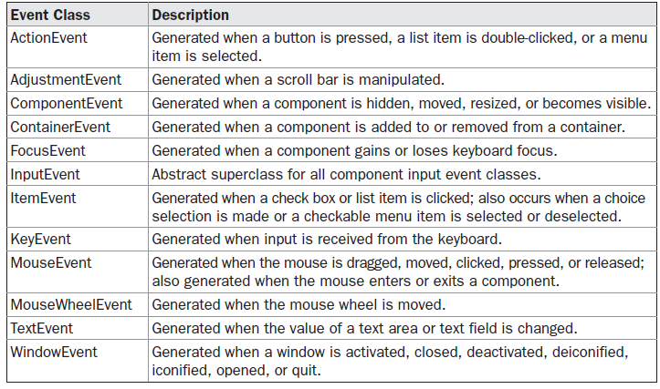

Slide 8
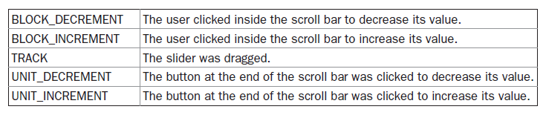
Adjustment Event Class
There are five types of adjustment events.
AdjustmentEvent(Adjustable src, int id, int type, int data)
src is a reference to the object that generated this event. The id specifies the event. The type of the adjustment is specified by type, and its associated data is data.

Slide 9
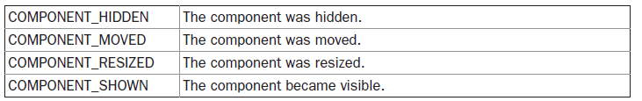
Component Event Class

Slide 10
Container Event Class
AContainerEvent is generated when a component is added to or removed from a container.
There are two types of container events. The ContainerEvent class defines int constants that can be used to identify them: COMPONENT_ADDED and COMPONENT_REMOVED.

Slide 11
Focus Event Class
AFocusEvent is generated when a component gains or loses input focus. These events are identified by the integer constants FOCUS_GAINED and FOCUS_LOST.

Slide 12
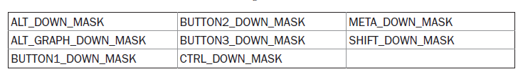
InputEvent Class
The abstract class InputEvent is a subclass of ComponentEvent and is the superclass for component input events. Its subclasses are KeyEvent and MouseEvent.

Slide 13

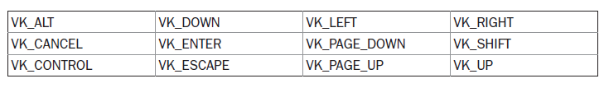
Item Event Class
Key Event Class
The VK constants specify virtual key codes and are independent of any modifiers, such as
control, shift, or alt.

Slide 14
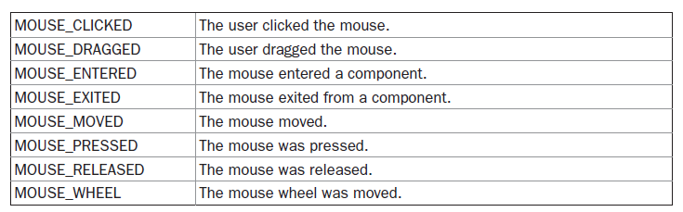
Mouse Event Class
int getButton( )
Returns – NOBUTTON or BUTTON1 or BUTTON2 or BUTTON3

Slide 15
MouseWheelEvent Class
WHEEL_BLOCK_SCROLL A page-up or page-down scroll event occurred.
WHEEL_UNIT_SCROLL A line-up or line-down scroll event occurred.
TextEvent Class
TextEvent defines the integer constant TEXT_VALUE_CHANGED.

Slide 16
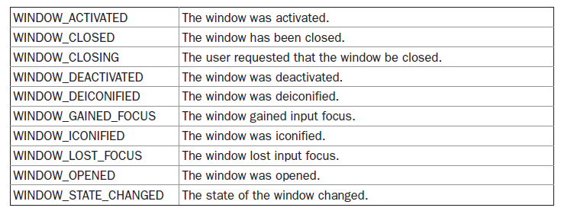
WindowEvent Class

Slide 17
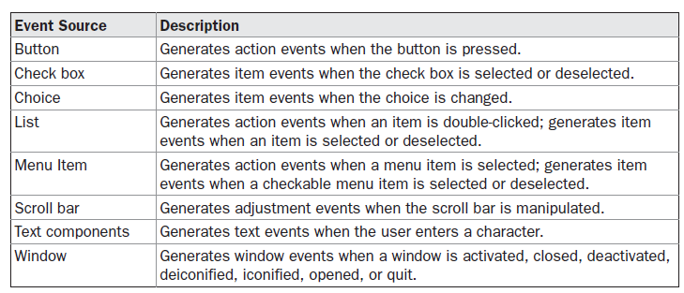
Sources of Events

Slide 18
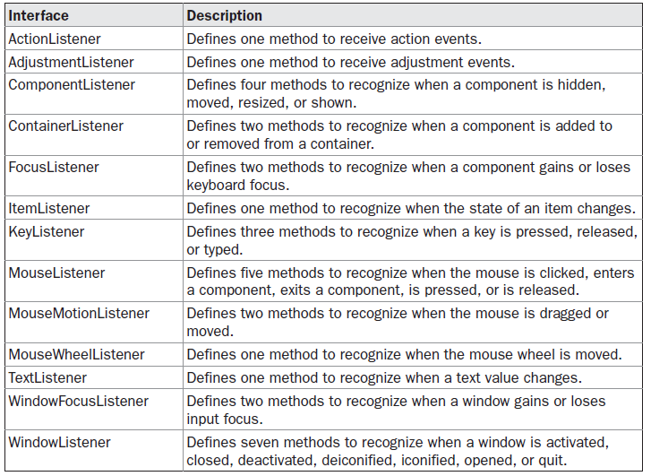
Event Listener Interfaces

Slide 19
Event Listener Interfaces
The AdjustmentListener Interface
void adjustmentValueChanged(AdjustmentEvent ae)
The ComponentListener Interface
void componentResized(ComponentEvent ce)
void componentMoved(ComponentEvent ce)
void componentShown(ComponentEvent ce)
void componentHidden(ComponentEvent ce)
The ContainerListener Interface
componentAdded( ) is invoked. When a component is removed from a container,
componentRemoved( ) is invoked. Their general forms are shown here:
void componentAdded(ContainerEvent ce)
void componentRemoved(ContainerEvent ce)

Slide 20
Event Listener Interfaces
The FocusListener Interface
void focusGained(FocusEvent fe)
void focusLost(FocusEvent fe)
The ItemListener Interface
void itemStateChanged(ItemEvent ie)
The KeyListener Interface
void keyPressed(KeyEvent ke)
void keyReleased(KeyEvent ke)
void keyTyped(KeyEvent ke)

Slide 21
Event Listener Interfaces
The MouseListener Interface
void mouseClicked(MouseEvent me)
void mouseEntered(MouseEvent me)
void mouseExited(MouseEvent me)
void mousePressed(MouseEvent me)
void mouseReleased(MouseEvent me)
The MouseMotionListener Interface
void mouseDragged(MouseEvent me)
void mouseMoved(MouseEvent me)
The MouseWheelListener Interface
void mouseWheelMoved(MouseWheelEvent mwe)

Slide 22
Event Listener Interfaces
The TextListener Interface
void textChanged(TextEvent te)
The WindowFocusListener Interface
void windowGainedFocus(WindowEvent we)
void windowLostFocus(WindowEvent we)
The WindowListener Interface
void windowActivated(WindowEvent we)
void windowClosed(WindowEvent we)
void windowClosing(WindowEvent we)
void windowDeactivated(WindowEvent we)
void windowDeiconified(WindowEvent we)
void windowIconified(WindowEvent we)
void windowOpened(WindowEvent we)

Slide 23
Applet
applets are small applications that are accessed on an Internet server, transported over the Internet, automatically installed, and run as part of a web document.
Applets are not structured in the same way as the programs that have been used thus far.

Slide 24
Applet
import java.awt.*;
import java.applet.*;
public class SimpleApplet extends Applet {
public void paint(Graphics g) {
g.drawString("A Simple Applet", 20, 20);
}
}
paint( ) is called each time that the applet must redisplay its output. This situation can occur for several reasons.
paint( ) is also called when the applet begins execution. Whatever the cause, whenever the applet must redraw its output, paint( ) is called.
drawString( ), which is a member of the Graphics class.
This method outputs a string beginning at the specified X,Y location.

Slide 25
Applet
Applets do not need a main( ) method.
Applets must be run under an applet viewer or a Java-compatible browser.
User I/O is not accomplished with Java’s stream I/O classes. Instead, applets use the interface provided by the AWT or Swing.

Slide 26
Handling Mouse Events
To handle mouse events, you must implement the MouseListener and the MouseMotionListener interfaces.
Our program applet demonstrates the process.
It displays the current coordinates of the mouse in the applet’s status window.
Each time a button is pressed, the word “Down” is displayed at the location of the mouse pointer. Each time the button is released, the word “Up” is shown.
If a button is clicked, the message “Mouse clicked” is displayed in the upperleft corner of the applet display area.

Slide 27
Handling Mouse Events
As the mouse enters or exits the applet window, a message is displayed in the upper-left corner of the applet display area. When dragging the mouse, a * is shown, which tracks with the mouse pointer as it is dragged.
Notice that the two variables, mouseX and mouseY, store the location of the mouse when a mouse pressed, released, or dragged event occurs. These
coordinates are then used by paint( ) to display output at the point of these occurrences.
Refer MouseEvents.pdf

Slide 28
Handling Keyboard Events
When a key is pressed, a KEY_PRESSED event is generated. This results in a call to the keyPressed( ) event handler.
When the key is released, a KEY_RELEASED event is generated and the keyReleased( ) handler is executed.
If a character is generated by the keystroke, then a KEY_TYPED event is sent and the keyTyped( ) handler is invoked.
Thus, each time the user presses a key, at least two and often three events are generated.
Refer SimpleKey.pdf and KeyEvents.pdf

